Slide 1
UNDERSTANDING SCHOOL AS LEARNING ORGANIZATION
Resource Person : Mrs. Sasmita Mohanty Time : 3.00 PM

Slide 2
Schools as learning organizations develop processes, strategies and structures that allow the schools to learn and react effectively in uncertain and dynamic environments. ... Effective use of data by teachers, school leaders and support staff has become central to school-improvement processes.

Slide 3
In short, a school as learning organization has the capacity to change and adapt routinely to new environments and circumstances as its members, individually and together, learn their way to realizing their vision.

Slide 4
The actions needed to transform schools into learning organizations: an overview
A shared and inclusive vision aims to enhance the learning experiences and outcomes of all students
The vision focuses on a broad range of learning outcomes, encompasses both the present and the future, and is inspiring and motivating
Learning and teaching are oriented towards realizing the vision
Vision is the outcome of a process involving all staff
Students, parents, the external community and other partners are invited to contribute to the school’s vision D

Slide 5
PROMOTING AND SUPPORTING CONTINUOUS PROFESSIONAL LEARNING FOR ALL STAFF
All staff engage in continuous professional learning
New staff receive induction and mentoring support
Professional learning is focused on student learning and school goals
Staff are fully engaged in identifying the aims and priorities for their own professional learning
Professional learning challenges thinking as part of changing practice
Professional learning connects work-based learning and external expertise
Professional learning is based on assessment and feedback
Time and other resources are provided to support professional learning
The school’s culture promotes and supports professional learning

Slide 6
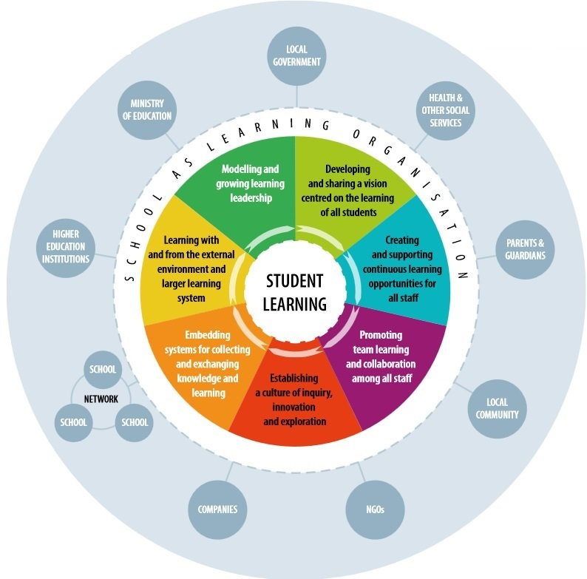
An integrated model of the school as learning organization

Slide 7
Key components of the professional life cycle
Induction | Mentoring | Continuous professional development Induction Mentoring
Formal | Acting as mentor | Participation
Informal | Receiving mentorship | Types/format/content
General/administrative introduction |  | Perceived impact
 |  | Support provided
 |  | Perceived needs
 |  | Perceived barriers

Slide 8
ASSESSING THE CHANGE AND INNOVATION CAPACITY IN SCHOOL SYSTEMS
Implementation of the schools as learning organizations assessment, which is based on the schools as learning organization model presented in this booklet. The assessment consists of a questionnaire for teachers and school leaders, and a background questionnaire, and is supported by desk research.

Slide 9
ORGANISING CONFERENCES AND SEMINARS TO FACILITATE PEER LEARNING
Conferences and/or seminars can be organized in participating countries to facilitate knowledge sharing and peer learning among schools, (local) policy makers and other stakeholders. These events will draw on the above mentioned review report and will be led by international experts.
Representatives of other countries and initiatives relevant to the participating country will also be invited. In turn, the target country will be invited to conferences and seminars organized by other countries.

Slide 10
BUILDING CHANGE AND INNOVATION CAPACITY WITHIN SCHOOLS AND LOCAL GOVERNMENTS

Slide 11
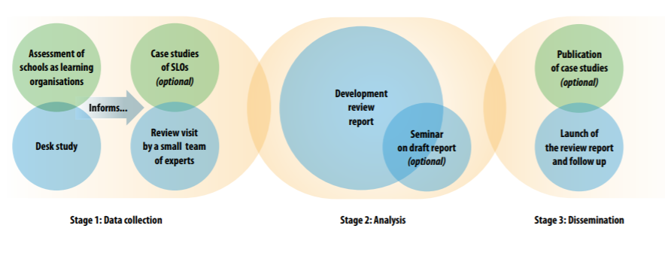
Overview proposed review methodology

Slide 12
WHAT???
Learning Organization was a term popularized by Peter Senge in the 90’s in his book “The Fifth Discipline.”
The concept has at least two aspects. Not only are all the members, as individual persons, continually learning but the organization itself is highly adaptable
Putting it that way raises the question of weather a organization can in fact be like a person in its ability to learn; to continually modify its shared knowledge and its practices in accord with experience.

Slide 13
SELF-RENEWING ORGANIZATION
The prime characteristic feature of any organization to be a learning organization is that it should be positively SELFRENEWING
So for a school to be a learning organization, it got to be self-renewing.
In the Fifth Discipline: The Art and Practice of Learning Organization, MIT professor Peter Senge (1990) tells us that:
Learning organizations are places in which, “People continually expand their capacity to create the result they truly desire, where new and expansive patterns of thinking are nurtured, where collective aspiration is set free, and where people are continually learning how to learn together.”
Learning organization discover overtime how to work together to create what members mutually want to do.

Slide 14
How is Learning Organization Initiated?
People continually expand their capacity to create the result they truly desire
New and expansive patterns of thinking are nurtured
Collective aspiration is set free
People are continually learning how to learn together
LEADING TO…
Discovery overtime how to work together to create what members mutually want to do.

Slide 15
How to create Learning Organization in a School as its Head
Have an incentive structure that encourages adaptive behavior .
Have Challenging but Achievable shared goals .
Have members who can accurately identify the organizations stages of development.
Gather, process and act upon information in ways best suited to their purposes .
Have an institutional knowledge base and process for creating new ideas .
Exchange information frequently with relevant external sources.
Get feedback on products and services rendered.
Continuously refine their basic processes.
Have a supportive organizational culture.

Slide 16
Characteristics of schools that are learning organization
They have an incentive structure that encourages adaptive behavior
They have challenging but achievable shared goals
They have members who can accurately identify the organizations stages of development.
They gather, process and act upon information in ways best suited to their purposes
They have an institutional knowledge base and process for creating new ideas
They exchange information frequently with relevant external sources.
They get feedback on products and services rendered
They continuously refine their basic processes
They have a supportive organizational culture
THEY ARE ‘OPEN SYSTEMS’ SENSITIVE TO THE EXTERNAL ENVIRONMENT INCLUDING SOCIAL, POLITICAL AND ECONOMICAL CONDITIONS

Slide 17
The five disciplines of learning organization
BUILDING SHARED VISION
PERSONALL MASTERY
MENTAL MODELS
TEAM LEARNING
SYSTEMS THINKING

Slide 18
BUILDING SHARED VISION
The first discipline starts with group commitment to developing shared "images of the future"
And then to the pursuit of the principles and practices of the learning cycle. Vision building never ends. It is not just building a "vision statement."
It is an ongoing process that engages all members of the organization in continually reflecting on what they, together, want to create.
All must see the picture of the future clearly, not just the leaders.
In a school, it involves a commitment from the principal to work with all stakeholders to discover (not dictate) the vision, to actualize it in the school, to regularly reflect on its evolution, and to accept the fact that it will and must change.

Slide 19
PERSONAL MASTERY
Personal mastery is creating and clarifying one's own vision and helping to create an organization that supports individuals in developing their personal skills.
Developing personal vision is the foundation of shared vision. Individuals must feel they can create their own lives in terms of what really matters to them. Real shared vision can develop in an organization only when all the individuals feel support in their personal quest for mastery.
It is not just an issue of staff development or access to training but of encouraging people to make a difference.

Slide 20
PERSONAL MASTERY
A school benefits from a highly skilled staff but relatively few educators try to achieve personal mastery in the skills that matter to them and that can make a real difference in their organization.
Some educators do achieve personal mastery, but they can become more frustrated than those who are simply putting in their time. Personal mastery is always accompanied by creative tension. The highly skilled learn to live with some dissatisfaction.
Those who truly strive know that their quest will never he finished but they are vitalized by the continuing challenge. A learning organization must feed on the vitality of those who are leading the way.

Slide 21
MENTAL MODELS
How our personal beliefs, ingrained assumptions, and pictures of the world affect and shape our thoughts and actions.
We filter our judgments and decisions through the mental models we have of reality. indeed, we tend to confuse reality with our picture of it. We readily assume that what we believe something to be is what the person or thing actually is. Organizational learning entails confronting our individual mental models, sharing them in risk-free and supportive settings, and striving to achieve a shared mental model for the organization.
Most of us are not consciously aware of our mental models. We can easily operate on such assumptions as "the boss is untrustworthy" or “Gemsten always sleeps in the class" without ever seeing him do it.

Slide 22
MENTAL MODELS
Organizations can share mental models that are equally deceptive. Principals often believe, and teachers accept, that vision should come from the top. School leaders may think of themselves as highly participative because they have a leadership team, but fail to recognize that their school structure is bureaucratic and their decision making highly authoritarian.
Mental models influence what we do because they color what we see.
Organizations can have great difficulty achieving a shared vision when the personal visions of their members are quite divergent. When individuals do not share their personal visions, they cannot confront the differences to mold a shared synthesis.
To achieve long-term improvement, schools and districts must change their shared mental models, initially by confronting their differences and then by creating, through dialogue, a new consensus

Slide 23
TEAM LEARNING
Organizations can confront the differences in their members' mental models and personal visions through team learning. The fourth discipline stipulates that teams, not individuals, are the fundamental units of learning in a modern organization.
Peter Senge (1990a) likes to point out the difference between "discussion" and "dialogue" in the development of team learning.
Discussion means to bat an idea back and forth as in a game, while dialogue connotes a conversation between people with a free flow of meaning. In discussion, we are trying to win, but in dialogue we attempt to go beyond individual understanding to gain new insight. The purpose of dialogue is to communicate individual differences in view so as to move beyond the differences.
Discussion supports convergent thinking; dialogue, divergent thinking. Dialogue does not seek agreement but rather a greater grasp of complexity. The successful learning team uses both processes depending on the objective.

Slide 24
SYSTEMS THINKING
The fifth discipline is the conceptual framework that integrates the other disciplines.
Systems thinking is a philosophy and set of principles that lends coherence to team learning, mental models, personal mastery, and shared vision. It is a body of knowledge and tools--information and processes -- that helps a learning organization discover its underlying operational patterns and how they can he changed.
These patterns are usually the impediments to substantive change in an organization, not the people or events. The tools of systems thinking -- causal loop diagrams, archetypes, and computer models -- enable the people in an organization to understand and talk about the interrelationships among the key components of the system. (Isaacson and Bomberg, 1992).

Slide 25
The first principle of systems thinking is that "structure influences behavior"
Systemic structures tend to cause particular patterns of behavior. These structures are not interrelationships among people but among such system components as population, resources, and methods of production. In a very real sense, a system causes its own behavior.
To understand any organization, event, or problem, we must look beyond people or bad luck to the underlying structures that influence and shape individual and group actions.
Senge (1990a) proposes 11 laws of systems thinking that help to explain how an organization will react in complex situations. The laws are as follows:

Slide 26
The 11 laws of system thinking
Today's problems come from yesterday's solutions.
The harder you push, the harder the system pushes back.
Behavior grows better before it grows worse
The easy way out usually leads back in.
The cure can be worse than the disease
Faster is slower.

Slide 27
Cause and effect are not closely related in time and space.
Small changes can produce big results -- but the areas of highest leverage are often the least obvious.
You can have your cake and eat it too -- but not at once.
Dividing an elephant in half does not produce two small elephants.
There is no blame.

Slide 28
MOVIE TIME…
Click here !!!

Slide 29
What kind of leader are you ?
Understanding and developing our own Leadership styles

Slide 30
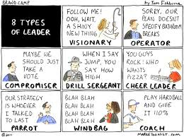
BUT BEFORE THAT….LET’S SEE THE TYPES

Slide 31
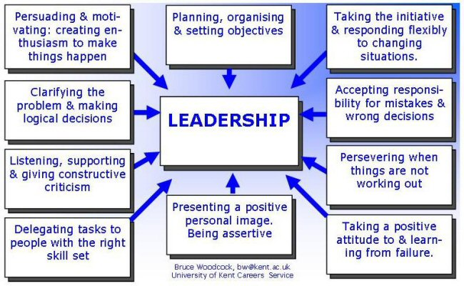

Slide 32
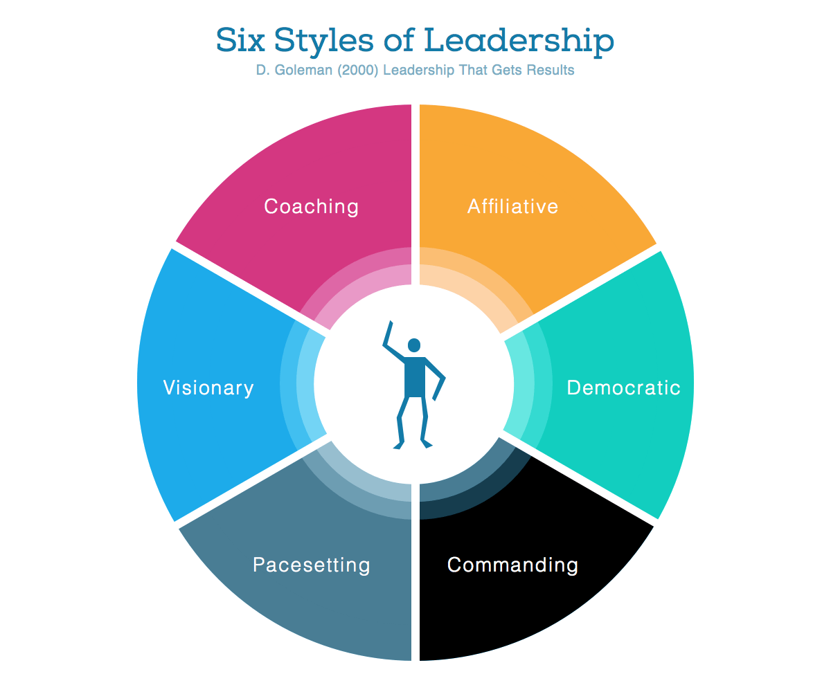

Slide 33
The Six Styles of Leadership
Visionary — mobilize people toward a vision. Works best when a clear direction or change is needed.
Most positive climate.
Coaching — develop people for the future. Works best when helping people and building long-term strength. Positive climate.
Affiliative — create emotional bonds and harmony. Works best to heal rifts in teams or motivate people in stressful times. Positive climate.
Democratic — build consensus through participation. Works best to create consensus or get input. Positive climate.
Pacesetting — expect excellence and self-direction. Works best to get quick results from a highly competent team. Negative climate.
Commanding — demand immediate compliance. Works best in crisis or with problematic people. Negative climate.

Slide 34
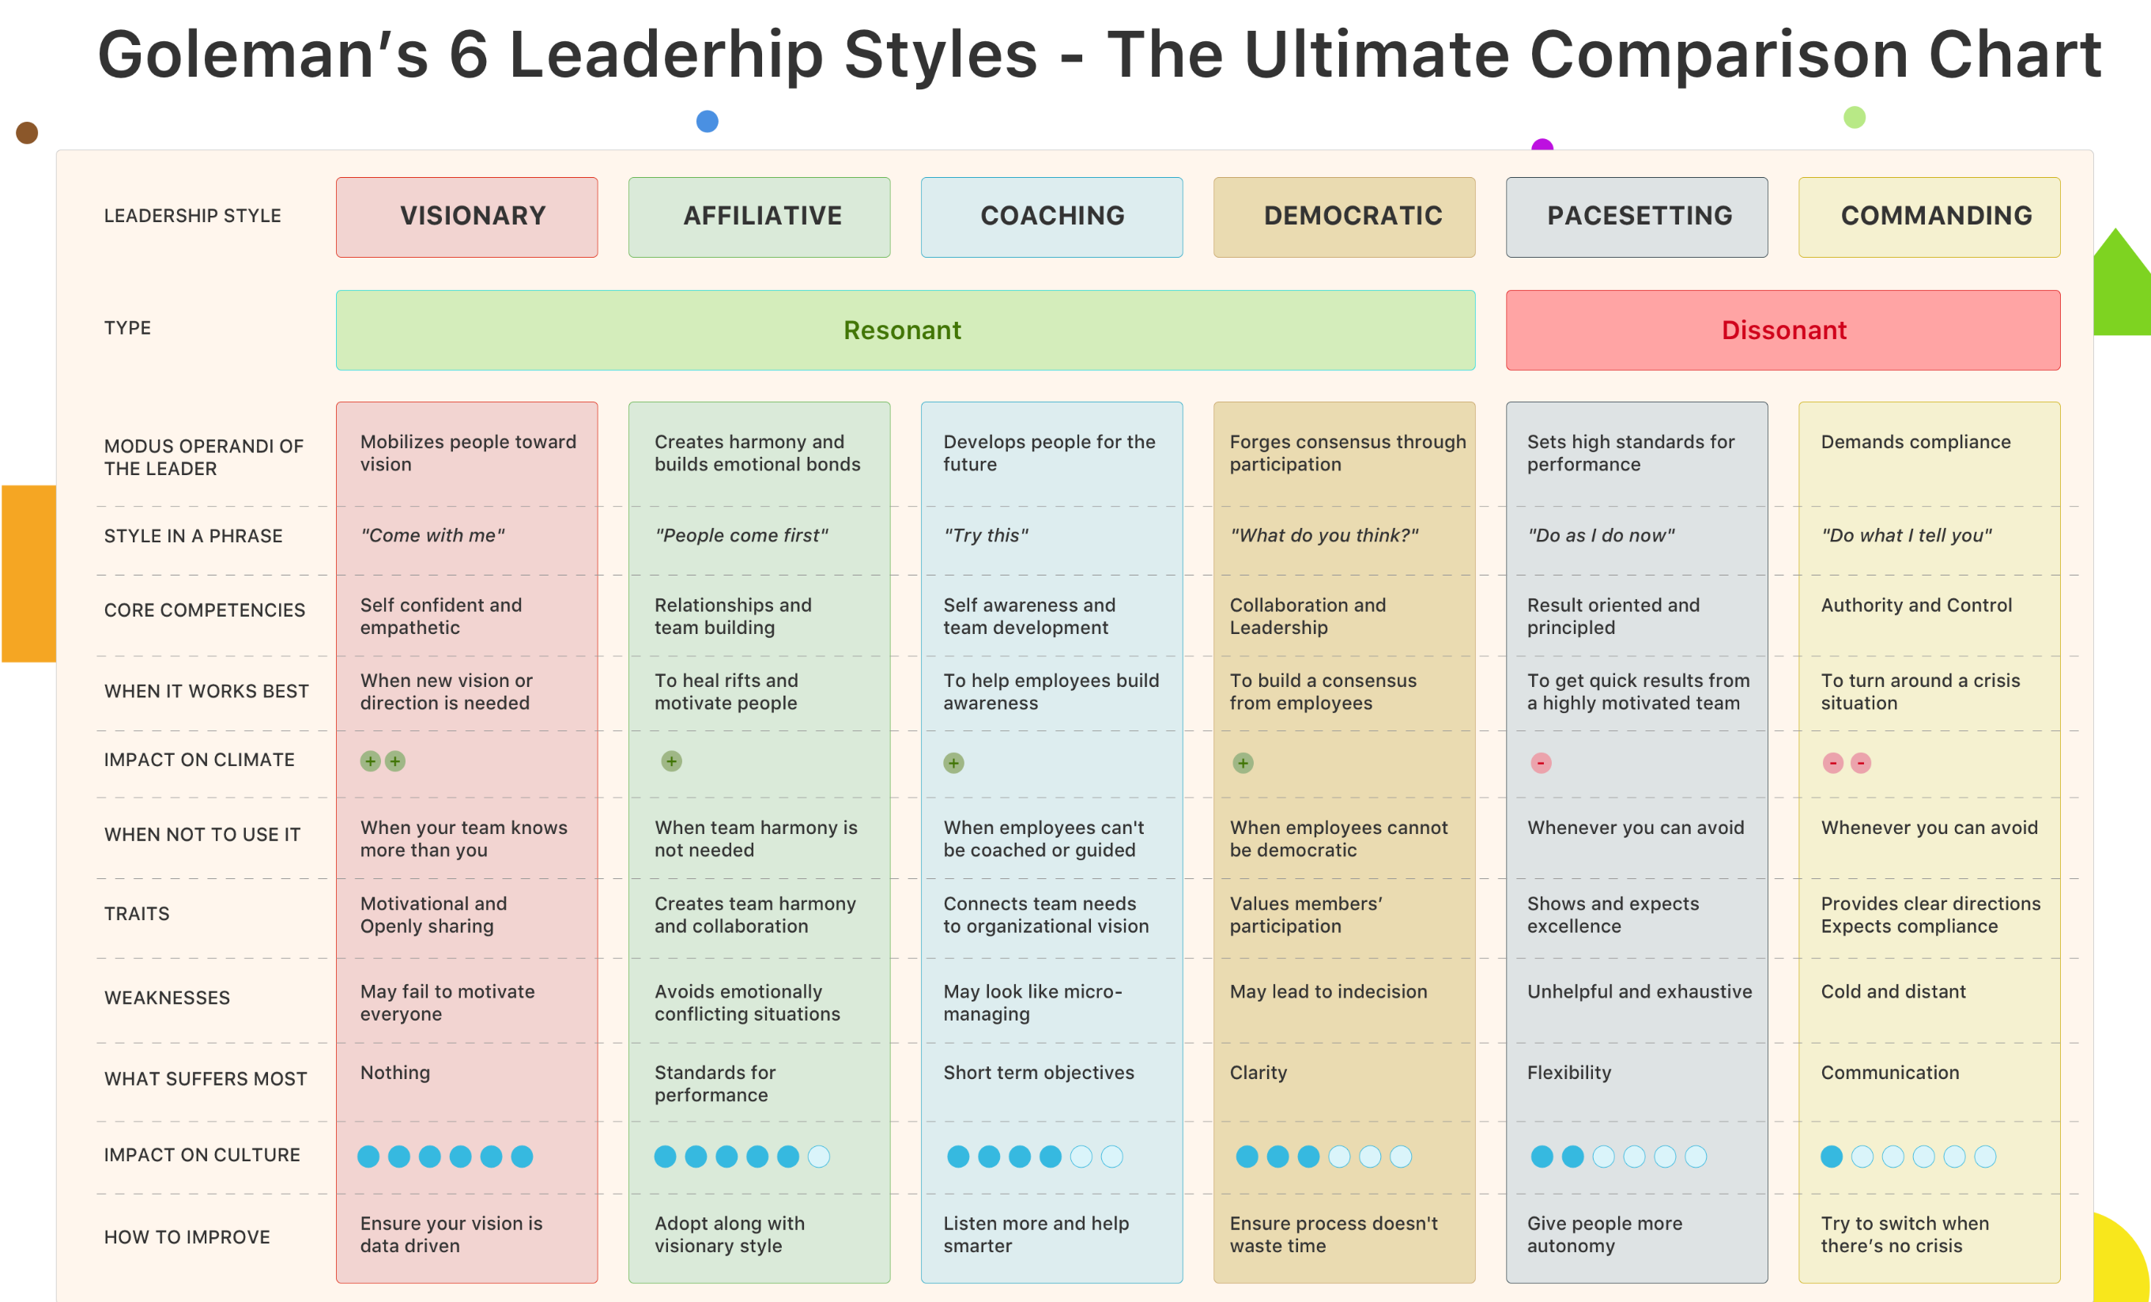

Slide 35


Slide 36


Slide 37
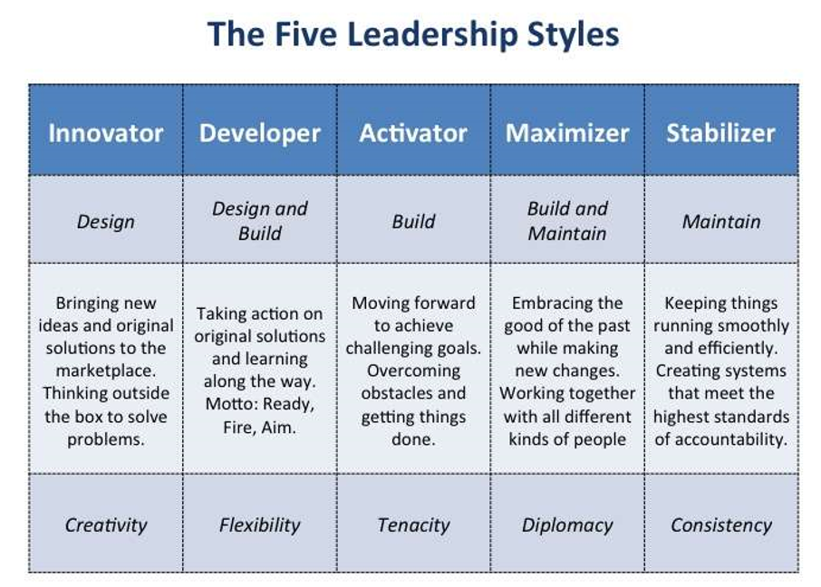

Slide 38


Slide 39
Customer
Environment
Stock holders
Employee
Society
Transformational Leader
Global
Government
Community
Market Place
Suppliers
Competition

Slide 40
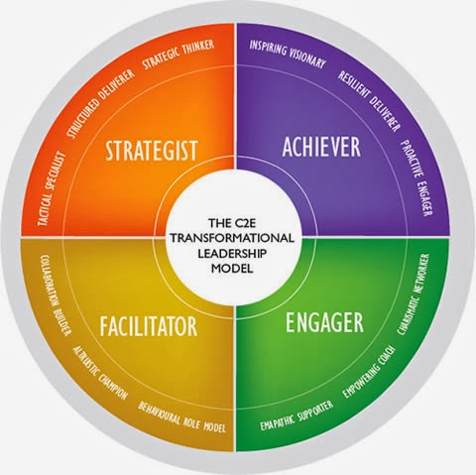

Slide 41
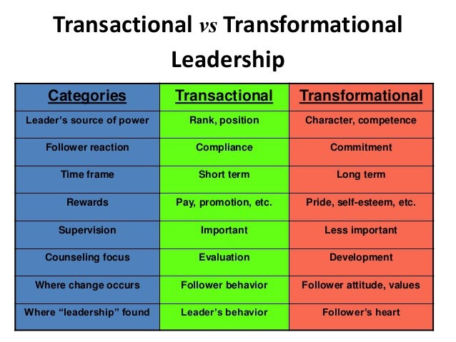

Slide 42
THE GENERAL TREND OF LEADERSHIP STYLES
In October last year, Grant Thornton, a global Business Accounting firm surveyed 3500 business leaders across 45 economies through the International Business Report (IBR)
It was conducted to understand what good leadership meant around the world
Respondents were asked a range of questions: from whether they have ever used a coach to what they think are the most attributes in

Slide 43
FINDING 1
Two distinct types of leader emerged from the research;
Modernists: in emerging markets like Brazil, Thailand, The Philippines and Vietnam saw leaders who were much more open to drawing on their intuition and their creative instincts;
Traditionalists: generally found in the European economies like France, Germany, Spain and the UK where intuition and creative instincts were given less importance.

Slide 44
FINDING 2
So the trend we see here is greater openness to coaching, greater emphasis to using creativity and intuition and more willingness to delegate
Leaders who are more likely to use their intuition or experience to make their decisions and are more open to a range of improvement techniques including setting challenging goals and monitoring progress, leadership skills assessments and developing peer networks are effective.
Three attributes of good leadership stood out globally and across all regions and sectors: integrity, positive attitude and communication.
Now that was in support of coaching otherwise called the Transformational leadership style

Slide 45
For now my vision is TRANSFORMATIONAL leadership because of the following reasons:
Transformational leadership is characterized by a focus on the concerns and needs of followers to develop them into semiautonomous entities that can act to advance the goals of an organization without the need of constant direction.
transformational style emphasizes the quality of the relationship between leader and follower through ethical role modelling, motivation and care for individual needs.
This style has even been compared to a completely selfless or “servant” style of leadership (Stone, Russell, & Patterson, 2004). According to this view, both transformational and servant leadership styles are characterized by role modelling, motivation, encouragement of risk- taking among subordinates and “individualized consideration,” but that while a transformational leader is ultimately concerned with the organization, a servant leader is more focused on the well-being of followers.
Yet, the overall intent of both transformational and servant leadership is to empower and motivate followers to work autonomously for the success of an organization.

Slide 46
For now my vision is TRANSFORMATIONAL leadership because of the following reasons…contd
In the field of educational leadership studies, Kirby, Paradise and King (1992) investigated the behaviors of exemplary educational leaders.
They quantitatively studied follower descriptions of “extraordinary” leaders for such characteristics as charisma and intellectual stimulation.
The findings suggested that leadership which focuses on the development of subordinates is preferred over educational systems that involve contingent reward.
There is also a series of studies showing that a leadership style emphasizing decentralized authority and subordinate development has positive influences on school culture and, eventually, learning outcomes.

Slide 47
For now my vision is TRANSFORMATIONAL leadership because of the following reasons…contd
further investigation by Leithwood and Mascall (2008) of the influence of “collective” leadership on learning outcomes revealed a relationship between the two:
transformational leadership styles that engender decentralized authority and collective responsibility among all stakeholders, including students and parents as well as teachers, had a positive relationship with the level of school achievement.
Interestingly, the authors also point out that the influence of the principals seems to increase as they allow subordinates more authority.

Slide 48
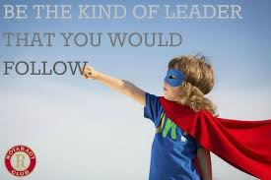
LAST BUT NOT THE LEAST

Slide 49
What kind of Leader do you intend to be ?

Slide 50


Slide 51
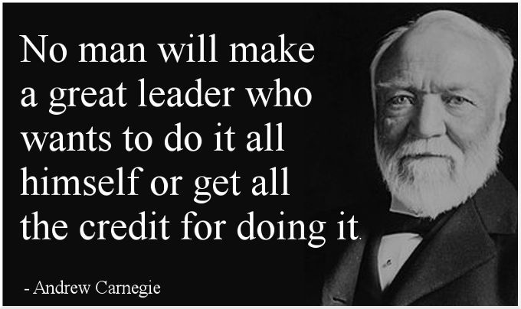

Slide 52
THAT WOULD BE….
The Leader in Me
Or at least I want to strive for….as I learn FOR I HAVE “MILES TO GO BEFORE I SLEEP; MILES TO GO BEFORE I SLEEP.”

Slide 53


